Slide 1
Tyler Woods – INTERNSHIP Summary
Rapid automation – analysis for developers (RAAD)

Slide 2



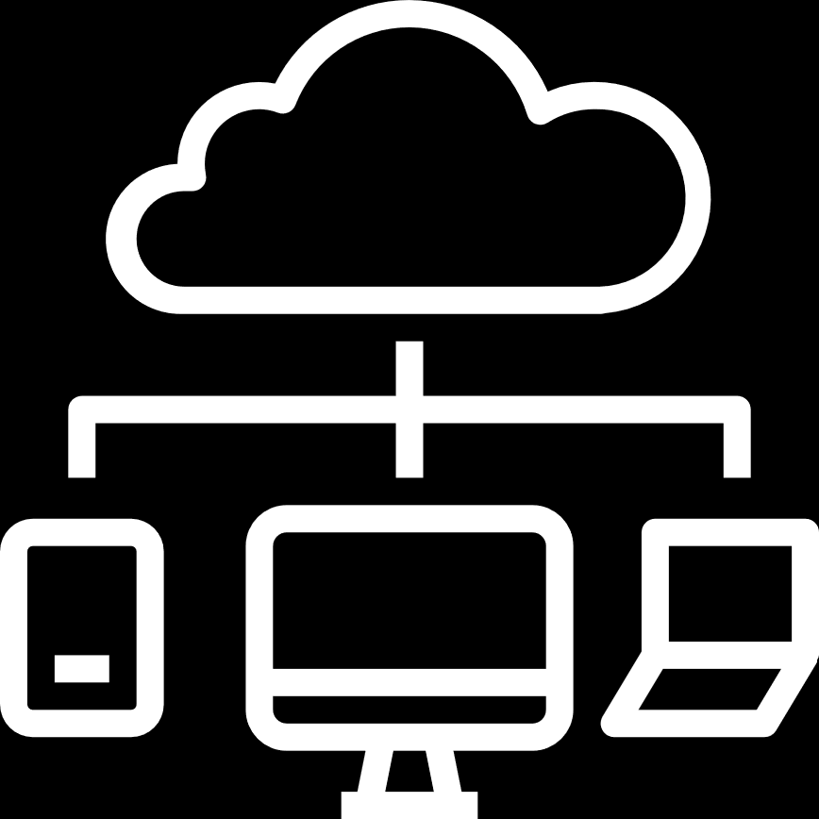


Thermal Prediction
Developed small software suite to gather and analyze telemetry (TEL) data
Used thermal TEL to conduct an exploratory review and visualize for preprocessing
Created a proof of concept to show that thermal TEL can easily relate instances to faults
Notes:
Talk about data collection, data preprocessing, data manipulation, and analysis

Slide 3
Ubiquitous solutions
Motivation behind this work was to find an automatic method to relate fault signatures
BKM was to send it back to Intel and an AE to triage and create a JIRA
Solution was to take TEL binaries from JIRA and relate any new faults a JIRA
Create a solution that does not require expert knowledge to adapt to new generations or faults
Notes:
Drives and firmware change frequently, so eccentricities in that data should not affect the prediction or require expert preprocessing(AE shouldn’t worry that one version of firmware has one object that might affect prediction)
Continuing this work would move on to auto-resolve the issue from the previous JIRA solution

Slide 4
What is the Matrix Profile?
Cosine similarity method to show discord in a time series instance
Matrix Profile is relative and normalized
Notes:
TODO: find image turning NAND, ASIC, composite to matrix profile
Matrix profile removes dependency on units
eventuates an event that changes the state of the system. i.e. Some action that pushes a drive into a fault

Slide 5
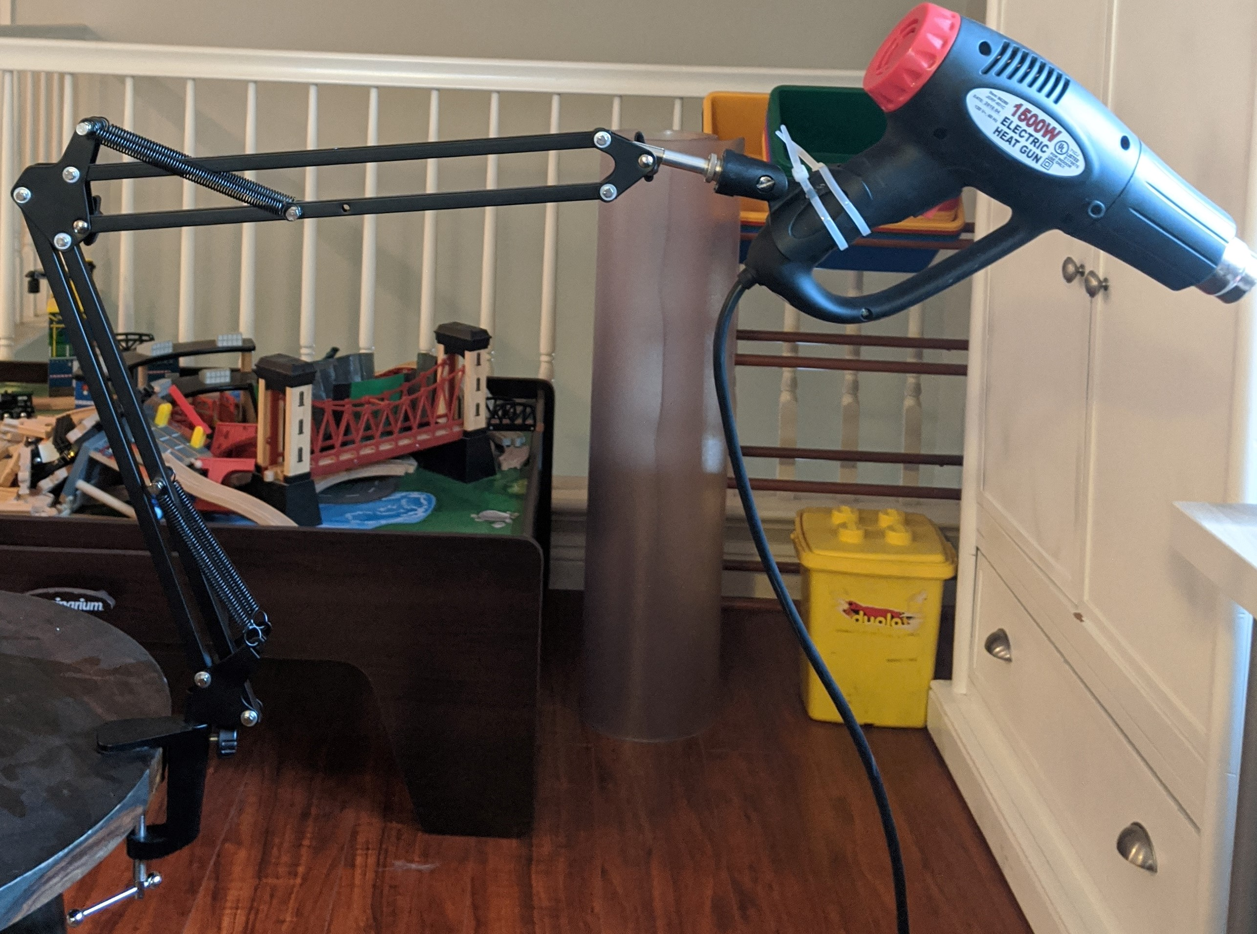
Thermal Prediction
Used the Matrix Profile and distance measurements to relate telemetry signatures with thermal faults

Slide 6
Proof of Concept
Gathered TEL over 60s under defined conditions(idle, heating, heating until failure)
Ran the matrix profile over every feature in every instance of telemetry
Calculated distance from TEL features to every time-series of TEL and fed into a simple neural network to identify matches
Notes:
Go into detail about how the we go from a time-series of telemetry data to the prediction

Slide 7
Results
Results would be enhanced with more instances of telemetry
Achieved 97% prediction with this very small dataset
IDF submitted related to this work is being submitted to the US Patent Office
Notes:
Met with thermal folks and talked about the results of our thermal prediction
@TODO: More papers than just this

Slide 8
New-snn
Developed program to enhance capabilities of many neural nets to one neural network
Created experiment to demonstrate the implications of the invention and achieved an accuracy of 90%
Received a Distinguished Inventor’s reward for the patent

Slide 9
New-snn Motivation
Neural networks in our drives learn valuable insights while deployed
Each of these insights are valuable, but normally require the training data to combine them
Our system proposes a method of topology, network, weights, and biases with one dataset

Slide 10
New-snn overview
Take our original neural network and one candidate network from the field
Networks are redacted architecture with redacted neurons
Retrain the network using the original dataset and the candidate network will adopt both behaviors

Slide 11
New-SNN OR Node
The novelty in this design is the neural network…
REDACTED

Slide 12
New-snn Results
Achieved over 93% accuracy in small experiment that learns two datasets
Achieved around 83% precision and 100% recall
IDF Received a Distinguished Invention Award

Slide 13
Rad pathfinding
Integrated team’s functions in RAD into a graphical interface
Worked with the AXON team for AXON integration into the data workflow of RAD
Further developed one-button approach that runs all of the RAD investigation and analysis

Slide 14
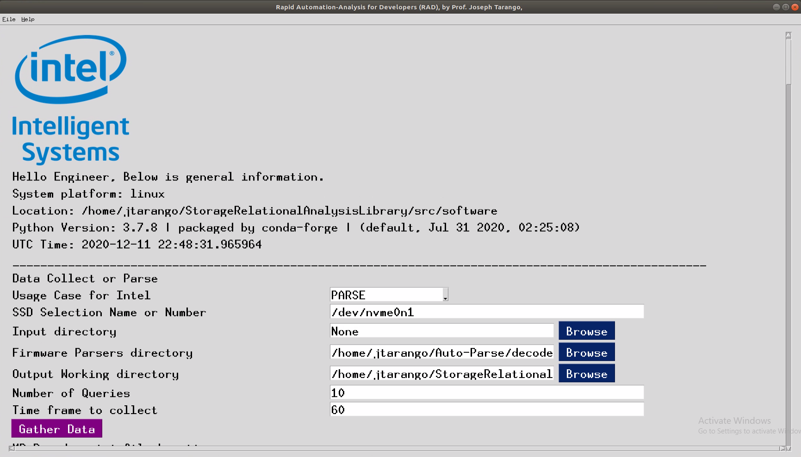
Rad graphical interface
Graphical interface gives user full understanding and control over the different step in the RAD flow
Good for demonstration purposes for people developing using this tool
Generates pertinent graphs and analysis to give the insights as laid out in phase 1 of RAD

Slide 15
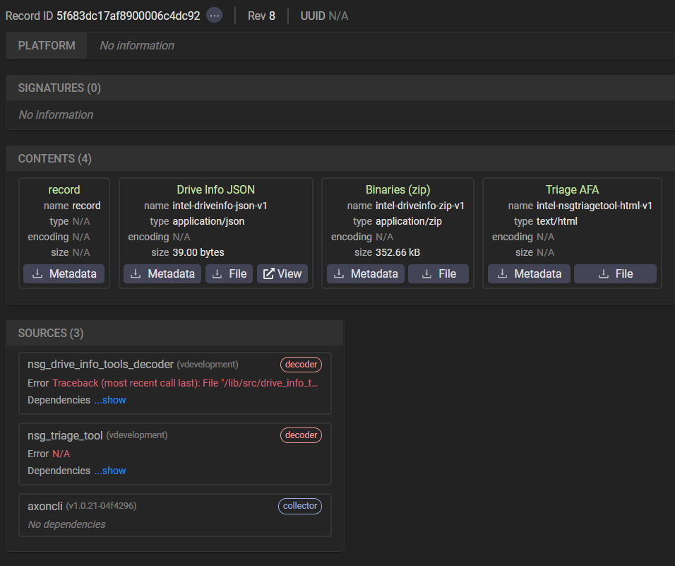
Axon database integration
AXON is a database capable of connecting our system to other team
Develop system to upload TEL data and retrieve TEL data for further use
Ongoing work with AXON team to bring the RAD use case into AXON

Slide 16
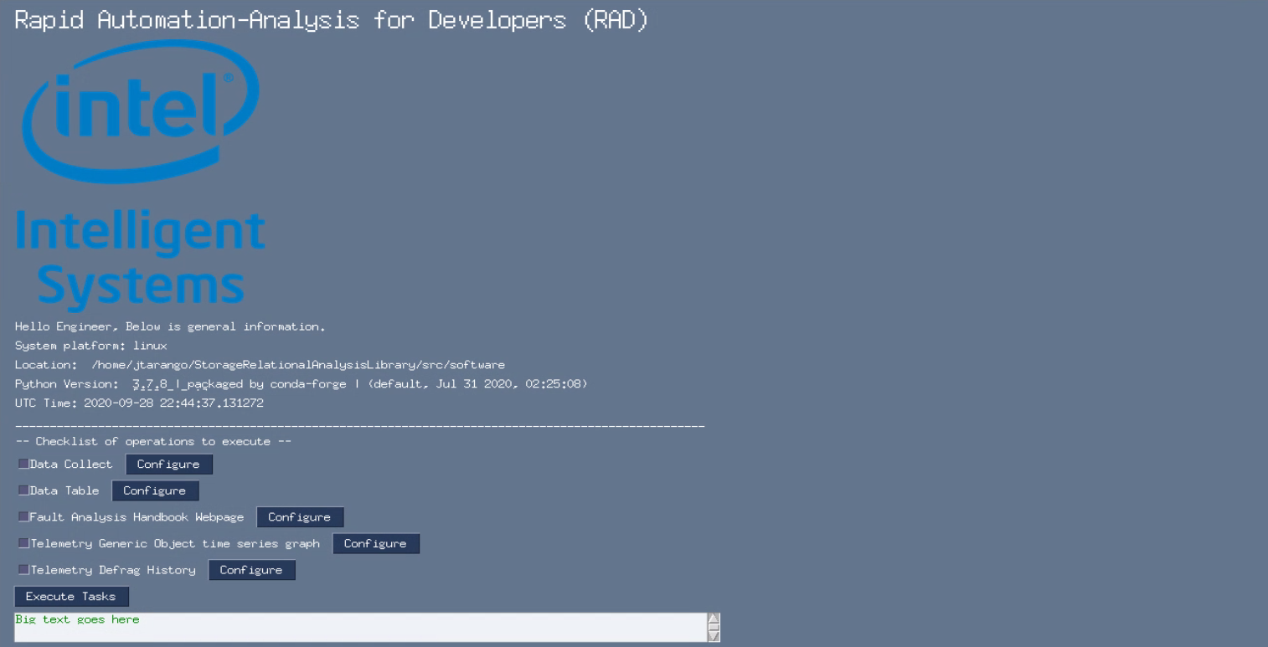
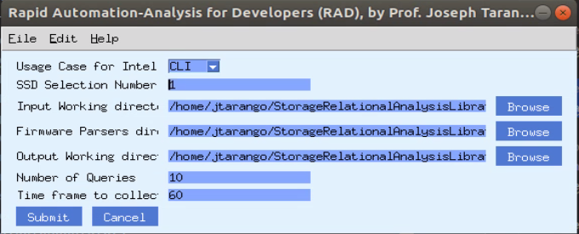
One-shot api and interface
Iterated graphical interface into a fully automatic framework
Can run through command line, function call, or GUI
Lenient error handling to ensure that the expected output is generated

Slide 17
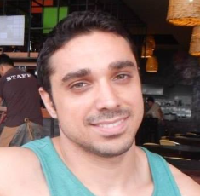
RECOGNITIONS
Special Recognition
Joe Tarango,
Intern Mentor
Jim Baca
Tyler Woods
Sanjeev Trika
Justin Gottschlich
Daniel Wright
Roberto Reyes
Vincent Quach
Alberto Sanchez
Quinn Quintana Phuong Tran
Randy Eike
Philip Low
Matt Beyer
Rutvij Karkhanis
Purav Vadodaria
Subha Sekaran

Slide 18
THANK YOU
Notes:
THANK YOU

Slide 19

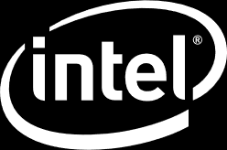
Notes:
END OF PRESENTATION

